Slide 1

Financial Analytics and Machine Learning
Prof. Simona Paravani-Mellinghoff, Prof. Fabrizio Coiai | UCL Institute of Finance and Technology
s.paravani@ucl.ac.uk

Slide 2
Agenda
CAPM
Fama-French 3 factors Model
Measuring risk premia and ML
Investment Strategies

Slide 3
1- CAPM

Slide 4
Key concepts
Higher return requires higher risk
Risk is represented by volatility i.e. standard deviation of returns over time period t
Two types of risk: systematic and unsystematic
Unsystematic risk: does not co-vary with market, stock/asset specific and can be diversified away
Systematic risk: market risk

Slide 5

Systematic Risk
The portion of systematic risk of a security is assessed by the extent to which a security’s returns vary in relation to the market i.e. they co-vary.
Measured by a parameter called beta which is defined as :
The CAPM model attempts to quantify the beta of a security and its expected return.

Slide 6
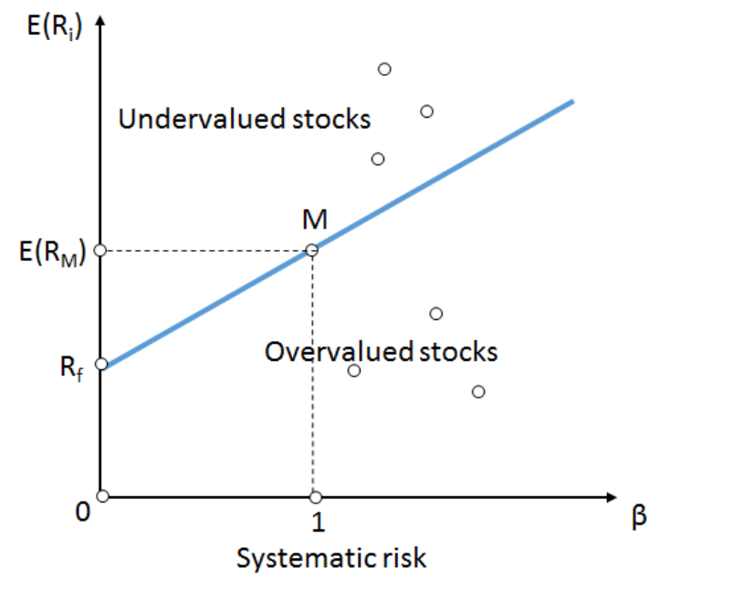

CAPM assumptions
Rational actors, only care about return and risk
Homogenous beliefs on risk/return trade-offs
One common risk factor: broad market
Source chart: https://en.wikipedia.org/wiki/Security_market_line

Slide 7
2 - FAMA FRENCH

Slide 8
FAMA FRENCH MODEL
Key intuition is that there are more factors than just broad market
Fama French 3 factors model is a seminal paper in a very critical body of research of predictability of asset prices
They identified two more factors:
Size = proxied as avg of smallest 30% - avg of largest 30%
Value = proxied as avg of highest 50% book to market value –avg of lowest 50% by B/M

Slide 9
3 - RISK PREMIA AND ML

Slide 10
Measuring the risk premia
Understand differences in expected returns among assets (cross-sectional)
Understand the dynamics of broad market over time (time series)
Why Machine Learning techniques are helpful?
Massive bodies of potential explanatory variables
Ambiguity on functional form: linear? non-linear?

Slide 11
4- INVESTMENT STRATEGIES

Slide 12
Definition of Investment Strategy
“An investment strategy is a term used in the financial and investing world to describe an approach to investing. Essentially, an investment strategy is a plan for selecting financial vehicles[instruments] tailored to the investor’s needs and goals, in addition to their risk appetite, specific interests and time horizon”.(Source: capital.com)

Slide 13
Investment Strategies
Value investing
Focus on stocks trading at discount relative to fundamentals
Typically associated with stocks trading at low valuation multiples (e.g. Price-to-Earnings, Price-to-Book)
Warren Buffett- probably most famous value investor
Growth investing
Focus on stocks with above average/history earnings growth potential
Tends to be associated possibly with higher valuation multiples

Slide 14
Investment Strategies
Momentum strategy
Involves a strategy to capitalize on the continuance of an existing market trend. It involves going long securities with upward trend in prices and short the respective assets with downward-trending prices. In practice, this is equivalent to building an auto-regressive model.
Contrarian strategy
Is characterized by purchasing and selling in contrast to the prevailing sentiment of the time

Slide 15
LET’S PRACTICE

Slide 16
Excercise
From Bloomberg download SP500 components from 2010/01/01 to 2022/02/01 at monthly frequencies. For each of the components, download: last price, Price-to-Earnings ratio (PE) and earning.
Compute Price-to-Earnings (PE), earnings growth over the last year, price change over the last 12 months.
Construct three portfolios based on these metrics:
select bottom 25% stocks based on PE, equally weighted among selected stocks
select top 25% stocks based on earnings growth, equally weighted among selected stocks
select top 25% stocks based on previous 12 months price change, equally weighted among selected stocks
Starting from 01/01/2011, implement these strategies with yearly rebalancing. Compute the performances at the end of the 10 years period and compare with respect to a buy and hold strategy on the SP500 index.
Repeat point I to IV, by including short positions in point III. Namely,
long bottom 25% and short top 25% stocks based on PE, equally weighted
long top 25% and short bottom 25% stocks based on earnings growth, equally weighted
long top 25% and short bottom 25% stocks based on previous 12 months price change, equally weighted

Slide 17
APPENDIX

Slide 18

Transformations
Given a series of prices $P_{t}, 1≤t≤T,$ then we can compute
Harmonic Mean
$$\frac{T}{\sum_{t=1}^{T}{\frac{1}{P_{t}}}}$$
Geometric Mean
$$\sqrt[T]{\prod_{t=1}^{T}{P_{t}}}$$
Log-returns
$$r_{t}=ln(\frac{P_{t}}{P_{t−1}})$$

Slide 19
References:
“Common risk factors in the returns on stocks and bonds”, Fama, E. F., & French, K. R., Journal of Financial Economics (1993).
“A comprehensive look at the empirical performance of equity premium prediction”. Welch I, Goyal A., The Review of Financial Studies. 2008 Jul 1;21(4):1455-508.
Investment Strategies To Learn Before Trading (investopedia.com)

Slide 20
All materials, including video lectures, can be used only and exclusively in relation to the Financial Analytics and Machine Learning course for the MSc in Banking and Digital Finance 2020/2021.No download, dissemination or reproduction is allowed.

